Slide 1
CST 202 :Computer Organization and Architecture

Slide 2

Course Outcome

Slide 3
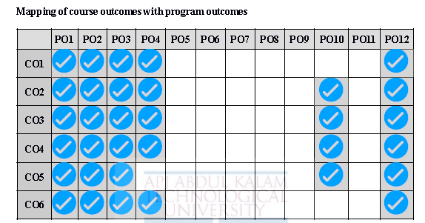
Mapping of course outcomes with program outcomes

Slide 4
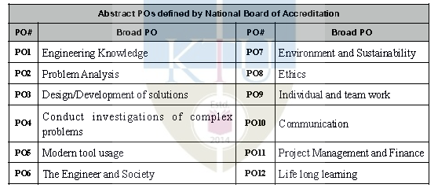
Abstract POs defined by National Board of Accreditation

Slide 5
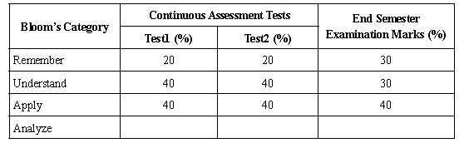
Assessment Pattern

Slide 6
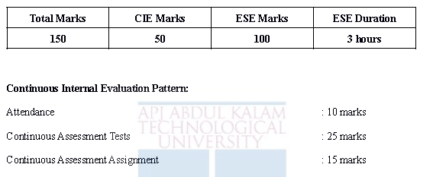
Mark Distribution

Slide 7

Textbook

Slide 8
SYLLABUS
Module 5
I/O organization: accessing of I/O devices – interrupts, interrupt hardware -Direct memory access.
Memory system: basic concepts – semiconductor RAMs. memory system considerations –ROMs, Content addressable memory, cache memories - mapping functions.

Slide 9
I/O organization
One basic features of a computer is its ability to exchange data with other devices

Slide 10
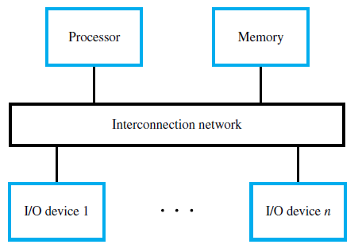
Accessing of I/O devices
The interconnection network consists of circuits needed to transfer information between the processor, the memory unit, and a number of I/O devices

Slide 11
A simple arrangement to connect I/O devices to a computer is to use a single bus structure. It consists of three sets of lines to carry
Address
Data
Control Signals.
When the processor places a particular address on address lines, the devices that recognize this address responds to the command issued on the control lines.
The processor request either a read or write operation and the requested data are transferred over the data lines.
When I/O devices & memory share the same address space, the arrangement is called memory mapped I/O.

Slide 12
Accessing of I/O devices
Recall the concept of an address space and how the processor may access individual memory locations within such an address space.
Load and Store instructions use addressing modes to generate effective addresses that identify the desired locations.
This idea of using addresses to access various locations in the memory can be extended to deal with the I/O devices as well.
For this purpose, each I/O device must appear to the processor as consisting of some addressable locations, just like the memory.

Slide 13
Accessing of I/O devices
Some addresses in the address space of the processor are assigned to these I/O locations, rather than to the main memory.
These locations are usually implemented as bit storage circuits (flip-flops) organized in the form of registers refer to as I/O registers.
Since the I/O devices and the memory share the same address space, this arrangement is called Memory-Mapped I/O. It is used in most computers.
With memory-mapped I/O, any machine instruction that can access memory can be used to transfer data to or from an I/O device.

Slide 14
Features | Memory Mapped IO | IO Mapped IO
Addressing | IO devices are accessed like any other memory location. | They cannot be accessed like any other memory location.
Address Size | They are assigned with 16-bit address values. | They are assigned with 8-bit address values.
Instructions Used | The instruction used are LDA and STA, etc. | The instruction used are IN and OUT.
Cycles | Cycles involved during operation are Memory Read, Memory Write. | Cycles involved during operation are IO read and IO writes in the case of IO Mapped IO.
Registers Communicating | Any register can communicate with the IO device in case of Memory Mapped IO. | Only Accumulator can communicate with IO devices in case of IO Mapped IO.
Space Involved | 2¹⁶ IO ports are possible to be used for interfacing in case of Memory Mapped IO. | Only 256 I/O ports are available for interfacing in case of IO Mapped IO.
Control Signal | No separate control signal required since we have unified memory space in the case of Memory Mapped IO. | Special control signals are used in the case of IO Mapped IO.

Slide 15
Features | Memory Mapped IO | IO Mapped IO
Arithmetic and Logical operations | Arithmetic and logical operations are performed directly on the data in the case of Memory Mapped IO. | Arithmetic and logical operations cannot be performed directly on the data in the case of IO Mapped IO.
Hardware requirements | Only one set of address and data buses are required for memory and I/O devices | Separate address and data buses are required for memory and I/O devices
Instruction set | Uses the same instructions for accessing both memory and I/O devices | Special instructions are used for accessing I/O devices
Address range | Limited number of memory locations available for use by the microprocessor | Dedicated address space available for I/O devices
Design complexity | Simple to implement and design | More complex to implement and design
Examples of processors | Intel 8085, Motorola 6800 | Intel 8255, Zilog Z80

Slide 16
I/O Device Interface
An I/O device is connected to the interconnection network by using a circuit, called the device interface,
which provides the means for data transfer and for the exchange of status and control information needed to facilitate the data transfers and govern the operation of the device.
The interface includes some registers that can be accessed by the processor, to
Serve as a buffer for data transfers,
Hold information about the current status of the device, and
Store the information that controls the operational behavior of the device.
These data, status, and control registers are accessed by program instructions as if they were memory locations.
Typical transfers of information are between I/O registers and the registers in the processor.

Slide 17
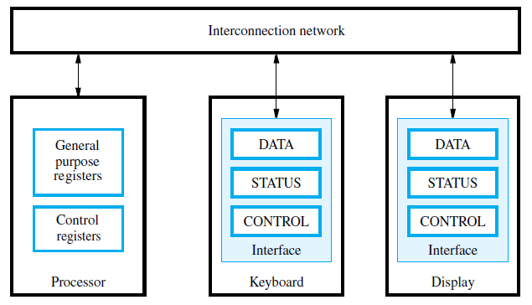

Slide 18
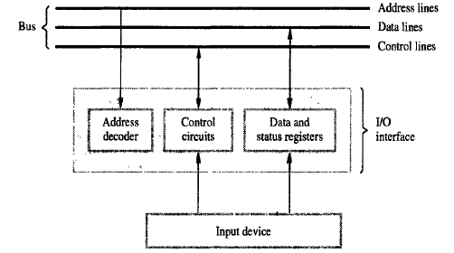
I/O interface for an input device

Slide 19
PROGRAM CONTROLLED I/O
There are various methods to access/ operate IO devices
Polling Method - the processor repeatedly checks a status flag to achieve the required synchronization between Processor & I/O device
Interrupt Method - Synchronization is achieved by having I/O device send special signal over the bus where is ready for data transfer operation.
DMA (Direct Memory Access) - It is a technique used for high speed I/O device. Here, the device interface transfer data directly to or from the memory without continuous involvement by the processor.

Slide 20
Limitations of programmed I/O
It is used only in some low-end microcomputers.
It has single input and single output instruction.
Each instructions selects one I/O device (by number) and transfers a single character (byte)
Example: microprocessor controlled video terminal.
Four registers: input status and character, output status and character.

Slide 21
Two other mechanisms used for synchronizing data transfers (handle I/O operations) between the processor and memory:
Interrupts.
Direct Memory Access.
Interrupt-driven I/O, employs I/O interrupts to indicate to the processor that an I/O device needs attention.
When a device wants to notify the processor that it has completed some operation or needs attention, it causes the processor to be interrupted.

Slide 22
Module 5
interrupts

Slide 23
Interrupts
It’s a method, where I/O device alert the processor when it becomes ready.
It can do so by sending a hardware signal called an interrupt request to the processor.
Since the processor is no longer required to continuously poll the status of I/O devices, it can use the waiting period to perform other useful tasks.
Indeed, by using interrupts, such waiting periods can ideally be eliminated.

Slide 24
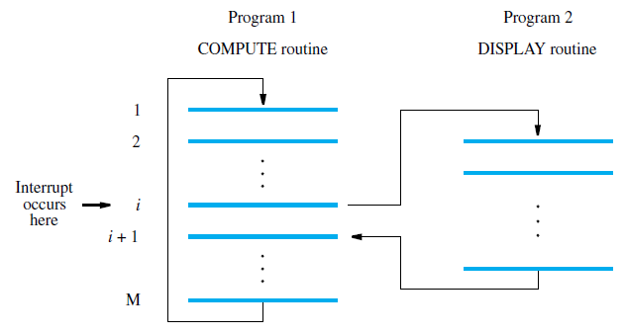
Interrupt Service Routine
The routine executed in response to an interrupt request is called the interrupt-service routine, (ISR)
Interrupts bear considerable resemblance to subroutine calls.

Slide 25
Interrupt Service Routine
Assume that an interrupt request arrives during execution of instruction i .
The processor first completes execution of instruction i.
Then, it loads the program counter with the address of the first instruction of the interrupt-service routine.
For the time being, let us assume that this address is hardwired in the processor.
After execution of the interrupt-service routine, the processor returns to instruction i + 1.
Therefore, when an interrupt occurs, the current contents of the PC, which point to instruction i + 1, must be put in temporary storage in a known location.
A Return-from-interrupt instruction at the end of the interrupt-service routine reloads the PC from that temporary storage location, causing execution to resume at instruction i + 1.
The return address must be saved either in a designated general-purpose register or on the processor stack.

Slide 26
Interrupt Acknowledge: A special control signal sent by Processor to inform the device that its interrupt request has been recognized so that it may remove its interrupt-request signal.
Even though the operations of interrupt is similar to subroutine, interrupt might not be related to the main program currently running
Interrupt latency: the delay between the time an interrupt request is received and the start of execution of the interrupt-service routine
Enabling and Disabling Interrupts: The processor has a status register (PS), which contains information about its current state of operation.
Let one bit, IE, of this register be assigned for enabling/disabling interrupts.

Slide 27
Enabling and Disabling of Interrupts
Ignoring Interrupts
Processor hardware ignores the interrupt request line until the execution of the first instruction of the ISR completed
Interrupt-Disable instruction as the first instruction of the ISR, no further interrupts till an Interrupt-Enable instruction executes.
Interrupt-Enable instruction is the last before RET instruction
A return from interrupt instruction is completed before further interruptions can occur
Disabling Interrupts
Processor automatically disables interrupts before starting the execution of ISR by setting Interrupt-Enable bit in PSR

Slide 28
The processor saves the contents of PC and PS (status register) before performing interrupt disabling.
Interrupt-Enable bit is set to 0 – no further interrupts allowed
When return from interrupt instruction is executed, contents of PS are restored from stack, and interrupt enable bit is set to 1.
Special Interrupt line
– Special interrupt request IRQ line for which the interrupt handling circuit responds only to the leading edge of the signal
– Processor receives only one request regardless of how long the line is activated
- No chance of multiple interruptions and hence no need for explicit interrupt disabling instructions

Slide 29
Procedure of Interrupt Handling
The device raises an interrupt request.
The processor interrupts the program currently being executed and saves the contents of the PC and PS registers.
Interrupts are disabled by clearing the IE bit in the PS to 0.
The action requested by the interrupt is performed by the interrupt-service routine, during which time the device is informed that its request has been recognized, and in response, it deactivates the interrupt-request signal.
Upon completion of the interrupt-service routine, the saved contents of the PC and PS registers are restored (enabling interrupts by setting the IE bit to 1), and execution of the interrupted program is resumed.

Slide 30
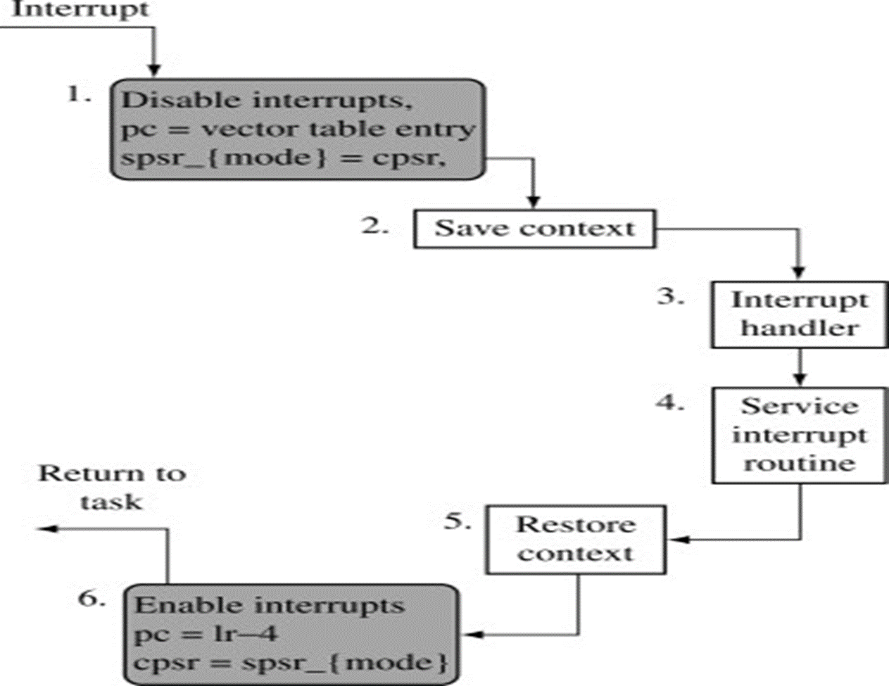

Slide 31
Interrupts
Interrupt-requests interrupt the execution of a program, and may alter the intended sequence of events:
Sometimes such alterations may be undesirable, and must not be allowed.
For example, the processor may not want to be interrupted by the same device while executing its interrupt-service routine.
Processors generally provide the ability to enable and disable such interruptions as desired.
One simple way is to provide machine instructions such as Interrupt-enable and Interrupt-disable for this purpose.
To avoid interruption by the same device during the execution of an interrupt service routine:
First instruction of an ISR can be Interrupt-disable.
Last instruction of an ISR can be Interrupt-enable.

Slide 32
Handling Multiple I/O devices
Multiple I/O devices may be connected to the processor and the memory via a bus. Some or all of these devices may be capable of generating interrupt requests.
Each device operates independently, and hence no definite order can be imposed on how the devices generate interrupt requests.
When several devices requests interrupt at the same time, it raises some questions. They are.
How does the processor know which device has generated an interrupt?
How does the processor know which interrupt service routine needs to be executed?
When the processor is executing an interrupt service routine for one device, can other device interrupt the processor?
If two interrupt-requests are received simultaneously, then how to break the tie?

Slide 33
Handling Multiple I/O devices
Polling
Consider a simple arrangement where all devices send their interrupt-requests over a single control line in the bus.
When the processor receives an interrupt request over this control line, how does it know which device is requesting an interrupt?
This information is available in the status register of the device requesting an interrupt: has an IRQ bit which it sets to 1 when it requests an interrupt.
Interrupt service routine can poll the I/O devices connected to the bus. The first device with IRQ equal to 1 is the one that is serviced.
Polling mechanism is easy
but time consuming to query the status bits of all the I/O devices connected to the bus.

Slide 34
Vectored Interrupts
The device requesting an interrupt may identify itself directly to the processor.
Device can do so by sending a special code (4 to 8 bits) to the processor over the bus.
Code supplied by the device may represent a part of the starting address of the interrupt-service routine.
The remainder of the starting address is obtained by the processor based on other information such as the range of memory addresses where interrupt service routines are located.
Usually the location pointed to by the interrupting device is used to store the starting address of ISR.

Slide 35
Interrupt Nesting – Priority Structure
Previously, before the processor started executing the interrupt service routine for a device, it disabled the interrupts from the device.
In general, same arrangement is used when multiple devices can send interrupt requests to the processor.
During the execution of an interrupt service routine of device, the processor does not accept interrupt requests from any other device.
Since the interrupt service routines are usually short, the delay that this causes is generally acceptable.
However, for certain devices this delay may not be acceptable.
Which devices can be allowed to interrupt a processor when it is executing an interrupt service routine of another device?

Slide 36
Interrupt Nesting
I/O devices are organized in a priority structure:
An interrupt request from a high-priority device is accepted while the processor is executing the interrupt service routine of a low priority device.
A priority level is assigned to a processor that can be changed under program control.
Priority level of a processor is the priority of the program that is currently being executed.
When the processor starts executing the interrupt service routine of a device, its priority is raised to that of the device.
If the device sending an interrupt request has a higher priority than the processor, processor accepts the interrupt request.

Slide 37
Processor’s priority is encoded in a few bits of the processor status register.
Priority can be changed by instructions that write into the processor status register called privileged instructions, or instructions that can be executed only in supervisor mode.
Privileged instructions cannot be executed in the user mode.
Prevents a user program from accidentally or intentionally changing the priority of the processor.
If there is an attempt to execute a privileged instruction in the user mode, it causes a special type of interrupt called as privilege exception.

Slide 38
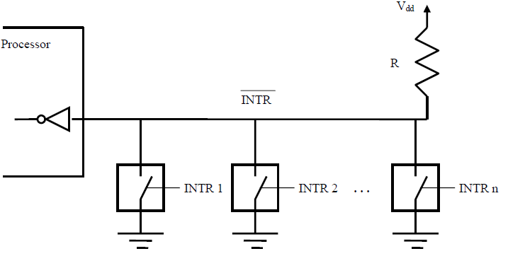
Interrupt hardware – using open-drain bus
A single interrupt-request line may be used to serve n devices
To request an interrupt, a device closes its associated switch
Since the closing of one or more switches will cause the line voltage to drop to 0, the value of INTR is the logical OR of the requests from individual devices, that is, INTR = INTR 1 ... INTRn

Slide 39
Interrupt Nesting – Priority Structure
I
N
T
R
1
I
N
T
R
p
Processor
Device 1
Device 2
Device
p
INTA1
INTA
p
Priority arbitration
Each device has a separate interrupt-request and interrupt-acknowledge line.
Each interrupt-request line is assigned a different priority level.
Interrupt requests received over these lines are sent to a priority arbitration circuit in the processor.
If the interrupt request has a higher priority level than the priority of the processor, then the request is accepted.

Slide 40
Interrupt Nesting – Priority Structure
Which interrupt request does processor accept if it receives interrupt requests from two or more devices simultaneously?.
If the I/O devices are organized in a priority structure, the processor accepts the interrupt request from a device with higher priority.
Each device has its own interrupt request and interrupt acknowledge line.
A different priority level is assigned to the interrupt request line of each device.
However, if the devices share an interrupt request line, then how does the processor decide which interrupt request to accept?

Slide 41
Simultaneous Requests
If the processor uses a polling mechanism to poll the status registers of I/O devices to determine which device is requesting an interrupt.
In this case the priority is determined by the order in which the devices are polled.
Polling scheme:
The first device with status bit set to 1 is the device whose interrupt request is accepted.

Slide 42
Simultaneous Requests
Daisy chain scheme
I
N
T
R
Processor
Device 1
Device 2
Device
n
INTA
Devices share the interrupt-request line, and interrupt-acknowledge line is connected to form a daisy chain.
Devices are connected to form a daisy chain.
When devices raise an interrupt request, the interrupt-request line is activated.
The processor in response activates interrupt-acknowledge.
Received by device1, if device1 do not need service, signal passed to device2.
Device that is electrically closest to the processor has highest priority.

Slide 43
Simultaneous Requests
When I/O devices were organized into a priority structure, each device had its own interrupt-request and interrupt-acknowledge line.
When I/O devices were organized in a daisy chain fashion, the devices shared an interrupt-request line, and the interrupt-acknowledge propagated through the devices.
A combination of priority structure and daisy chain scheme can also used.
I
N
T
R
1
INTA1
Device
Device
Processor
I
N
T
R
p
INTA
p
Device
Device
Priority arbitration
circuit
Devices are organized into groups.
Each group is assigned a different priority level.
All the devices within a single group share an interrupt-request line, and are connected to form a daisy chain.

Slide 44
Interrupt Enable Bit
Only those devices that are being used in a program should be allowed to generate interrupt requests.
To control which devices are allowed to generate interrupt requests, the interface circuit of each I/O device has an interrupt-enable bit.
If the interrupt-enable bit in the device interface is set to 1, then the device is allowed to generate an interrupt-request.
Interrupt-enable bit in the device’s interface circuit determines whether the device is allowed to generate an interrupt request.
Interrupt-enable bit in the processor status register or the priority structure of the interrupts determines whether a given interrupt will be accepted.

Slide 45
Module 5
DMA

Slide 46
Direct memory access
Blocks of data are often transferred between the main memory and I/O devices such as disks.
When transferring a block of data, instructions are needed to increment the memory address and keep track of the word count.
The use of interrupts involves operating system routines which incur additional overhead to save and restore processor registers, the program counter, and other state information
An alternative approach is used to transfer blocks of data directly between the main memory and I/O devices, such as disks.
A special control unit is provided to manage the transfer, without continuous intervention by the processor.
This approach is called direct memory access, or DMA.
The unit that controls DMA transfers is referred to as a DMA controller.

Slide 47
Direct memory access
Although a DMA controller transfers data without intervention by the processor, its operation must be under the control of a program executed by the processor, usually an operating system routine.
To initiate the transfer of a block of words, the processor sends to The DMA controller the starting address, the number of words in the block, and the direction of the transfer.
The DMA controller then proceeds to perform the requested operation.
When the entire block has been transferred, it informs the processor by raising an interrupt

Slide 48
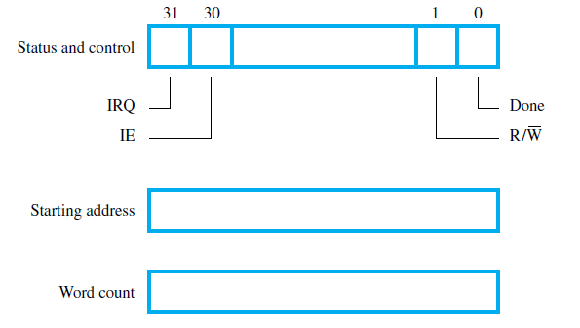
Typical registers in a DMA controller
When the controller has completed transferring a block of data and is ready to receive another command, it sets the Done flag to 1.
Bit 30 is the Interrupt-enable flag, IE.
When this flag is set to 1, it causes the controller to raise an interrupt after it has completed transferring a block of data.
Finally, the controller sets the IRQ bit to 1 when it has requested an interrupt.

Slide 49
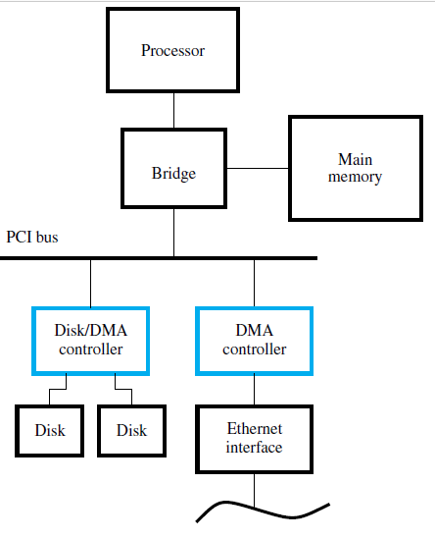
Use of DMA controllers in a computer system.
To start a DMA transfer of a block of data from the main memory to one of the disks,
An OS routine writes the address and word count information into the registers of the disk controller.
The DMA controller proceeds independently to implement the specified operation.
When the transfer is completed, this fact is recorded in the status and control register of the DMA channel by setting the Done bit.
At the same time, if the IE bit is set, the controller sends an interrupt request to the processor and sets the IRQ bit.
The status register may also be used to record other information, such as whether the transfer took place correctly or errors occurred.

Slide 50
Direct Memory Access
Conflicts in DMA: Processor and DMA controllers have to use the bus in an interwoven fashion to access the memory.
DMA devices are given higher priority than the processor to access the bus.
Among different DMA devices, high priority is given to high-speed peripherals such as a disk or a graphics display device.
Two types of DMA transfer:
Cycle stealing- Since the processor originates most memory access cycles on the bus, DMA controller can be said to “steal” memory access cycles from the bus. Hence, this interweaving technique is usually called cycle stealing
Block or burst mode – provides a DMA controller an exclusive capability to initiate transfers on the bus, and hence exclusive access to the main memory. The DMA controller may transfer a block of data without interruption.
Notes:
Processor also has to transfer data to and from the main memory. Also, the DMA controller is responsible for transferring data to and from the I/O device to the main memory. Both the processor and the DMA controller have to use the external bus to talk to the main memory. Usually, DMA controllers are given higher priority than the processor to access the bus. Now, we also need to decide the priority among different DMA devices that may need to use the bus. Among these different DMA devices, high priority is given to high speed peripherals such as a disk or a graphics display device.
Usually, the processor originates most cycles on the bus. The DMA controller can be said to steal memory access cycles on from the bus. Thus, the processor and the DMA controller use the bus in an interwoven fashion. This interweaving technique is called as cycle stealing.
An alternate approach would be to provide DMA controllers exclusive capability to initiate transfers on the bus, and hence exclusive access to the main memory. This is known as the block mode or the burst mode of operation.

Slide 51

DMA-Burst mode
Burst transfer is the fastest way to transfer memory data.
Once an input block is ready and desired I/O bandwidth matches the computer bus bandwidth, a burst mode DMA is requested, then the computer can be completely halted, while the block of data is transferred all at once into memory.
The DMA controller assumes that source and destination memory address/IO port can transfer and accept the data as quickly as the DMA controller can produce them, so after the controller is set up and the CPU has released control of the address and data buses, the entire block of memory is copied to the destination as a single contiguous block.
For the entire duration of the transfer, the CPU stays idle and the DMA controller and the peripheral device gets complete access to system buses.

Slide 52

DMA-Cycle Stealing Mode
Cycle Stealing mode- When DMA controller wants to read/write via the bus it makes the CPU wait (controller always has higher priority on bus).
If the I/O bandwidth is less than the computer bus bandwidth, then the DMA hardware will steal cycles and transfer the data one DMA cycle at a time. During the cycle steal DMA, instead of the data being transferred all at once, it is transferred one byte at a time. .
The DMA controller, after transferring one byte of data, releases control of the system buses by sending a bus grant signal through the control bus, lets the CPU process an instruction and then requests access to the bus by sending the bus request signal through the control bus and then transfers another byte of data. This keeps going on until all the data has been transferred.
Transfer rate is slower but CPU will not stay idle for a long period of time.

Slide 53
Bus arbitration
Processor and DMA controllers both need to initiate data transfers on the bus and access main memory.
The device that is allowed to initiate transfers on the bus at any given time is called the bus master.
When the current bus master relinquishes its status as the bus master, another device can acquire this status.
Bus arbitration-The process by which next device to become the bus master is selected and bus mastership is transferred to.
Centralized arbitration:
A single bus arbiter performs the arbitration.
Distributed arbitration:
All devices participate in the selection of the next bus master.
Notes:
Processor and DMA controllers both need to initiate data transfers on the bus and access main memory. The process of using the bus to perform a data transfer operation is called as the initiation of a transfer operation. At any point in time only one device is allowed to initiate transfers on the bus. The device that is allowed to initiate transfers on the bus at any given time is called the bus master. When the current bus master releases control of the bus, another device can acquire the status of the bus master. How does one determine which is the next device which will acquire the status of the bus master. Note that there may be several DMA controllers plus the processor which requires access to the bus. The process by which the next device to become the bus master is selected and bus mastership is transferred to it is called bus arbitration. There are two types of bus arbitration processes. Centralized arbitration and distributed arbitration. In case of centralized arbitration, a single bus arbiter performs the arbitration. Whereas in case of distributed arbitration all devices which need to initiate data transfers on the bus participate or are involved in the selection of the next bus master.

Slide 54
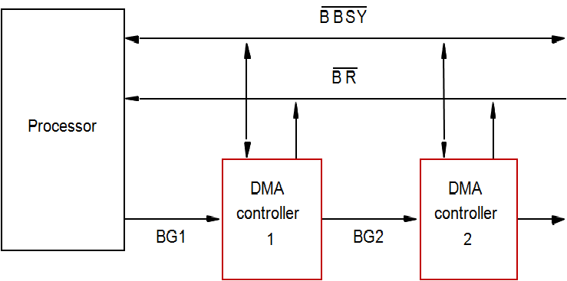
Centralized Bus Arbitration

Slide 55
Centralized Bus Arbitration
Bus arbiter may be the processor or a separate unit connected
to the bus.
Normally, the processor is the bus master, unless it grants bus mastership to one of the DMA controllers.
DMA controller requests the control of the bus by asserting the Bus Request (BR) line.(active low)
In response, the processor activates Bus-Grant1 (BG1) line, indicating that the controller may use the bus when it is free.
BG1 signal is connected to all DMA controllers in a daisy chain fashion.
BBSY signal (active low)is 0, it indicates that the bus is busy, already in use.
When BBSY=1, the DMA controller which asserted BR can acquire control of the bus.

Slide 56
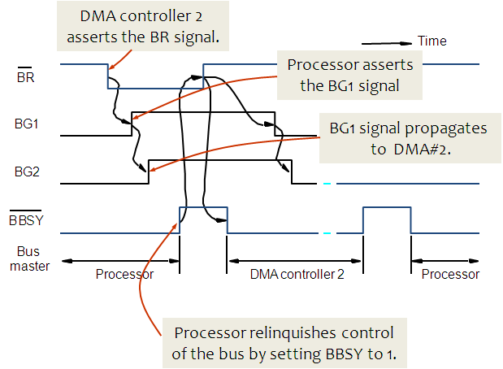
Centralized Bus Arbitration

Slide 57
Distributed arbitration
All devices waiting to use the bus share the responsibility of carrying out the arbitration process.
Arbitration process does not depend on a central arbiter and hence distributed arbitration has higher reliability.
Each device is assigned a 4-bit ID number.
All the devices are connected using 5 lines, 4 arbitration lines to transmit the ID, and one line for the Start-Arbitration signal.
To request the bus a device:
Asserts the Start-Arbitration signal.
Places its 4-bit ID number on the arbitration lines.
The pattern that appears on the arbitration lines is the logical-OR of all the 4-bit device IDs placed on the arbitration lines.

Slide 58
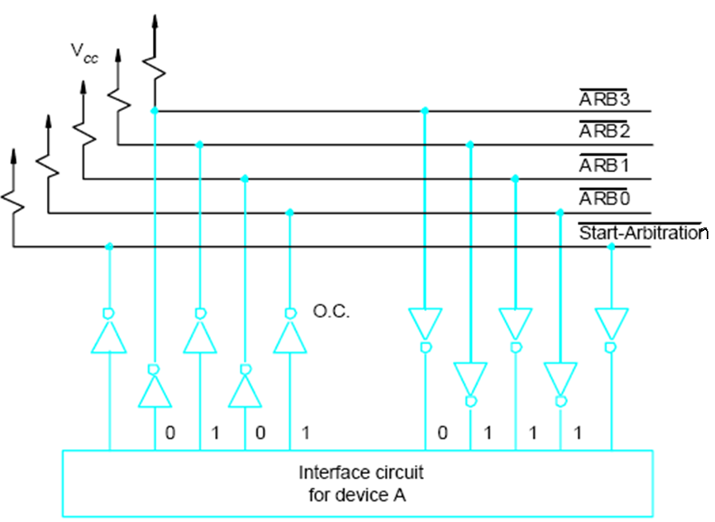
Distributed arbitration

Slide 59
Distributed arbitration
Distributed Arbitration process:
To request the bus a device has to:
Asserts the Start-Arbitration signal.
Places its 4-bit ID number on the arbitration lines.
The pattern that appears on the arbitration lines is the logical-OR of all the 4-bit device IDs placed on the arbitration lines.
Each device compares the pattern that appears on arbitration lines to its own ID, starting with MSB.
If it detects a difference, it transmits 0s on the arbitration lines from that onwards on all lower bit positions.
The pattern that appears on the arbitration lines is the logical-OR of all the 4-bit device IDs placed on the arbitration lines.

Slide 60
Distributed arbitration - example
Arbitration process:
Device A has the ID 5 and wants to request the bus- Transmits the pattern 0101 on the arbitration lines.
Device B has the ID 6 and wants to request the bus - Transmits the pattern 0110 on the arbitration lines.
Pattern on the arbitration lines is the logical OR of the patterns - Pattern 0111 appears on the arbitration lines.
Each device compares the pattern that appears on the arbitration lines to its own ID, starting with MSB.
If it detects a difference, it transmits 0s on the arbitration lines for that and all lower bit positions.
Device A compares its ID 5 (pattern 0101) to pattern 0111.
It detects a difference at 3rd bit position , as a result, device A transmits a pattern 0100 on the arbitration lines.
Device B compares its ID 6 (pattern 0110) to pattern 0111 (4th bit) and transmits a pattern 0110 on the arbitration lines.
The final pattern that appears on the arbitration lines is logical-OR of 0100 and 0110, which is pattern 0110 (same as the device ID of B) and hence B has won the arbitration.

Slide 61
Module 5
Memory system
-Basics
CST 202 : Computer Organization
& Architecture

Slide 62
Memory system- Basic concepts
Programs and the data they operate on are held in the memory of the computer.
The execution speed of programs is highly dependent on the speed with which instructions and data can be transferred between the processor and the memory.
It is also important to have sufficient memory to facilitate execution of large programs having large amounts of data.
Ideally, the memory would be fast, large, and inexpensive.
Unfortunately, it is impossible to meet all three of these requirements simultaneously.
Increased speed and size are achieved at increased cost.
The memory of a computer comprises a hierarchy, including a cache, the main memory, and secondary storage,

Slide 63
Memory system- Basic concepts
The maximum size of the memory that can be used in any computer is determined by the addressing scheme.
A computer that generates 16-bit addresses is capable of addressing up to 2¹⁶ = 64K (kilo) memory locations.
Machines whose instructions generate 32-bit addresses can utilize a memory that contains up to 2³² = 4G (giga) locations, whereas
Machines with 64-bit addresses can access up to 2⁶⁴ = 16E (exa) ≈ 16 × 1018 locations.
The number of locations represents the size of the address space of the computer
The memory is usually designed to store and retrieve data in word-length quantities.

Slide 64
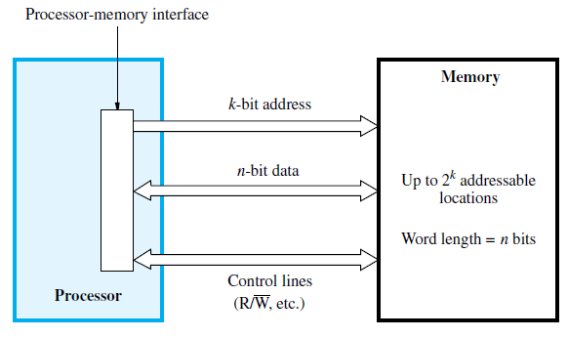

Slide 65
Memory system- Basic concepts
The processor uses the address lines to specify the memory location involved in a data transfer operation, and uses the data lines to transfer the data.
At the same time, the control lines carry the command indicating a Read or a Write operation and whether a byte or a word is to be transferred.
The control lines also provide the necessary timing information and are used by the memory to indicate when it has completed the requested operation.
When the processor-memory interface receives the memory’s response, it asserts the MFC signal.
This is the processor’s internal control signal that indicates that the requested memory operation has been completed.
When asserted, the processor proceeds to the next step in its execution sequence.

Slide 66
Memory system- Basic concepts
A useful measure of the speed of memory units is the time that elapses between the initiation of an operation to transfer a word of data and the completion of that operation. This is referred to as the memory access time.
Another important measure is the memory cycle time, which is the minimum time delay required between the initiation of two successive memory operations, for example, the time between two successive Read operations. The cycle time is usually slightly longer than the access time, depending on the implementation details of the memory unit.
A memory unit is called a random-access memory (RAM) if the access time to any location is the same, independent of the location’s address.
This distinguishes such memory units from serial, or partly serial, access storage devices such as magnetic and optical disks. Access time of the latter devices depends on the address or position of the data.
The technology for implementing computer memories uses semiconductor integrated circuits.

Slide 68
Cache Memory
The processor of a computer can usually process instructions and data faster than they can be fetched from the main memory.
The memory access time is the bottleneck in the system.
One way to reduce the memory access time is to use a cache memory.
This is a small, fast memory inserted between the larger, slower main memory and the processor.
It holds the currently active portions of a program and their data.

Slide 69
Cache Memory
Cache memory is used to reduce the average time to access data from the Main memory.
The cache is a smaller and faster memory which stores copies of the data from frequently used main memory locations.
There are various different independent caches in a CPU, which store instructions and data.
Locality of Reference
Analysis of programs indicates that many instructions in localized areas of a program are executed repeatedly during some period of time, while the others are accessed relatively less frequently. These instructions may be the ones in a loop, nested loop or few procedures calling each other repeatedly. This is called “locality of reference”.
Temporal locality of reference: Recently executed instruction is likely to be executed again very soon.
Spatial locality of reference: Instructions with addresses close to a recently instruction are likely to be executed soon.

Slide 70
Basic Cache Operations
Processor issues a Read request; a block of words is transferred from the main memory to the cache, one word at a time.
Subsequent references to the data in this block of words are found in the cache.
At any given time, only some blocks in the main memory are held in the cache, which blocks in the main memory in the cache is determined by a “mapping function”.
When the cache is full, and a block of words needs to be transferred from the main memory, some block of words in the cache must be replaced. This is determined by a “replacement algorithm”.
Cache hit :
Existence of a cache is transparent to the processor. The processor issues Read and Write requests in the same manner. If the data is in the cache, it is called a Read or Write hit.

Slide 71
Basic Cache Operations
If the data is not present in the cache, then a Read miss or Write miss occurs.
Read miss: Block of words containing this requested word is transferred from the memory. After the block is transferred, the desired word is forwarded to the processor. The desired word may also be forwarded to the processor as soon as it is transferred without waiting for the entire block to be transferred. This is called load-through or early restart.
Write-miss: Write-through protocol is used, and then the contents of the main memory are updated directly. If write-back protocol is used, the block containing the addressed word is first brought into the cache. The desired word is overwritten with new information.

Slide 72
Virtual Memory
With this technique, only the active portions of a program are stored in the main memory, and the remainder is stored on the much larger secondary storage device.
Sections of the program are transferred back and forth between the main memory and the secondary storage device in a manner that is transparent to the application program.
As a result, the application program sees a memory that is much larger than the computer’s physical main memory.

Slide 73
Block Transfers
In the virtual memory technique data move frequently between the main memory and the cache and between the main memory and the disk.
These transfers do not occur one word at a time. Data are always transferred in contiguous blocks involving tens, hundreds, or thousands of words.
Data transfers between the main memory and high-speed devices such as a graphic display or an Ethernet interface also involve large blocks of data.
Hence, a critical parameter for the performance of the main memory is its ability to read or write blocks of data at high speed.
This is an important consideration that we will encounter repeatedly as we discuss memory technology and the organization of the memory system.

Slide 74
Module 5
Semiconductor
ram
CST 202 : Computer Organization
& Architecture

Slide 75
Semiconductor RAMs
Semiconductor random-access memories (RAMs) are available in a wide range of speeds.
Their cycle times range from 100 ns to less than 10 ns.

Slide 76
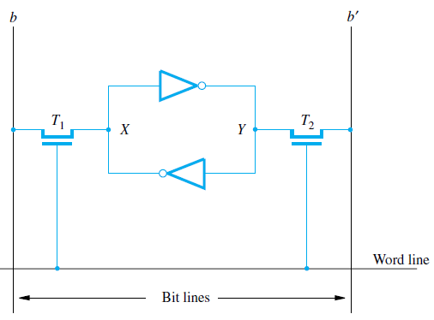
Static Memories (SRAM)
Memories that consist of circuits capable of retaining their state as long as power is applied are known as static memories
Two inverters are cross-connected to form a latch. The latch is connected to two bit lines by transistors T1 and T2.
These transistors act as switches that can be opened or closed under control of the word line.
When the word line is at ground level, the transistors are turned off and the latch retains its state.
For example, if the logic value at point X is 1 and at point Y is 0, this state is maintained as long as the signal on the word line is at ground level. Assume that this state represents the value 1.

Slide 77
Static Memories (SRAM)
Read operation: In order to read state of SRAM cell, the word line is activated to close switches T1 and T2.
Sense/Write circuits at the bottom monitor the state of b and b’.
Write operation: During the write operation, the state of the cell is set by placing the appropriate value on bit line b and its complement on b’ and then activating the word line.
This forces the cell into the corresponding state.
The major advantage of SRAM is very quickly accessed by the processor.
The major disadvantage is that SRAM are expensive memory and SRAM are Volatile memory.
If the power is interrupted, the cell’s content will be lost.
Continuous power is needed for the cell to retain its state.

Slide 78
Dynamic Memories (DRAM)
Static RAMs are fast, but the cost is too high because their cells require several transistors.
Less expensive RAMs can be implemented if simpler cells are used.
Such cells don't retain their state indefinitely; hence they are called dynamic RAMs
Dynamic RAMs (DRAMs) are cheap and area efficient, but they cannot retain their state indefinitely – need to be periodically refreshed.
Dynamic memory cell consists of a capacitor C, and a transistor T.

Slide 79
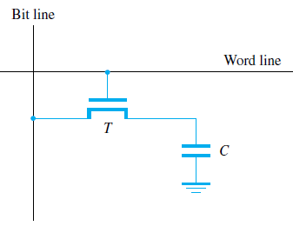
Dynamic Memories (DRAM)
Information is stored is a dynamic memory cell in the form of charge on a capacitor and this charge can be maintained for only tens of milliseconds.
Since the cell is required to store information for a much longer time, its contents must be periodically refreshed by restoring the capacitor charge to its full value.
Read Operation: Transistor turned on, Sensor check voltage of capacitor. If voltage is less than Threshold value, Capacitor discharged and it represents logical „0‟ else if voltage is above Threshold value, Capacitor charged to full voltage and it represents Logical „1‟
Write Operation - Transistor is turned on and a voltage is applied/removed to the bit line

Slide 80
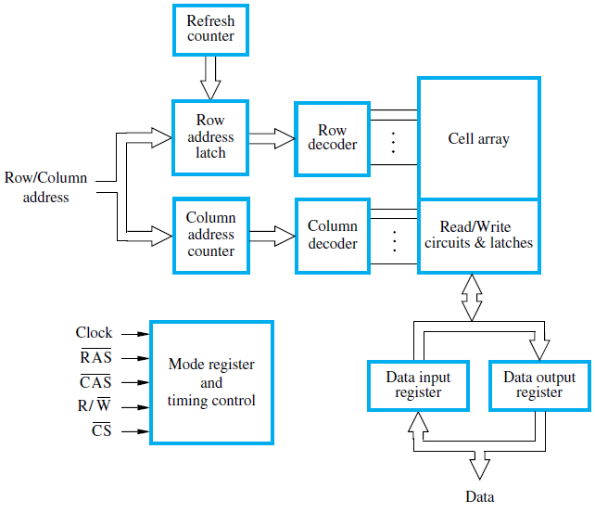
Synchronous DRAMs
Operation is directly synchronized with processor clock signal.
The outputs of the sense circuits are connected to a latch.
During a Read operation, the contents of the cells in a row are loaded onto the latches.
During a refresh operation, the contents of the cells are refreshed without changing the contents of the latches.

Slide 81
Asynchronous Dynamic RAM
In Asynchronous dynamic RAM, the timing of the memory device is controlled asynchronously.
A specialized memory controller circuit provides the necessary control signals, RAS and CAS, which govern the timing.
The processor must take into account the delay in the response of the memory
In the diagram above, we can see that there are two extra elements with two extra lines attached to them: the Row Address Latch is controlled by the RAS (or Row Address Strobe) pin, and the Column Address Latch is controlled by the CAS (or Column Address Strobe) pin.

Slide 82
Fast Page Mode
Suppose if we want to access the consecutive bytes in the selected row. This can be done without having to reselect the row. Add a latch at the output of the sense circuits in each row.
All the latches are loaded when the row is selected.
Different column addresses can be applied to select and place different bytes on the data lines.
Consecutive sequence of column addresses can be applied under the control signal CAS, without reselecting the row.
This methodology allows a block of data to be transferred at a much faster rate than random accesses
A small collection/group of bytes is usually referred to as a block.This transfer capability is referred to as the fast page mode feature.
This mode of operation is useful when there is requirement for fast transfer of data (Eg: Graphical Terminals)

Slide 83
Static RAM | Dynamic RAM
More expensive | Less expensive
No refresh | Deleted & refreshed
High power | Less power
Less storage capacity | Higher storage capacity
MOS transistors | Transistor & capacitor
Faster | Slow
More reliable | Less reliable

Slide 84
Module 5
Internal Organization of Memory Chips
CST 202 : Computer Organization
& Architecture

Slide 85
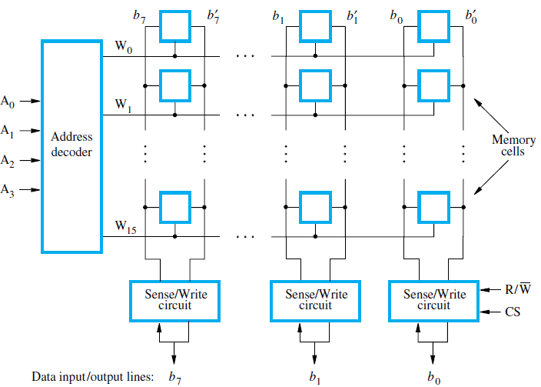
Internal Organization of Memory Chips
This is an example of a very small memory circuit consisting of 16 words of 8 bits each.
This is referred to as a 16 × 8 organization
Stores 128 bits
Requires 14 external connections for address, data, and control lines

Slide 86
Internal Organization of Memory Chips
Memory cells are usually organized in the form of an array, in which each cell is capable of storing one bit of information
Each row of cells constitutes a memory word,
All cells of a row are connected to a common line referred to as the word line,
World line is driven by the address decoder on the chip.
The cells in each column are connected to a Sense/Write circuit by two bit lines.
The Sense/Write circuits are connected to the data input/output lines of the chip.
During a Read operation, these circuits sense, or read, the information stored in the cells selected by a word line and transmit this information to the output data lines.
During a Write operation, the Sense/Write circuits receive input information and store it in the cells of the selected word

Slide 87
Internal Organization of Memory Chips
The data input and the data output of each Sense/Write circuit are connected to a single bidirectional data line that can be connected to the data lines of a computer.
Two control lines, R/W and CS, are provided.
The R/W (Read/Write) input specifies the required operation, and
The CS (Chip Select) input selects a given chip in a multichip memory system

Slide 88
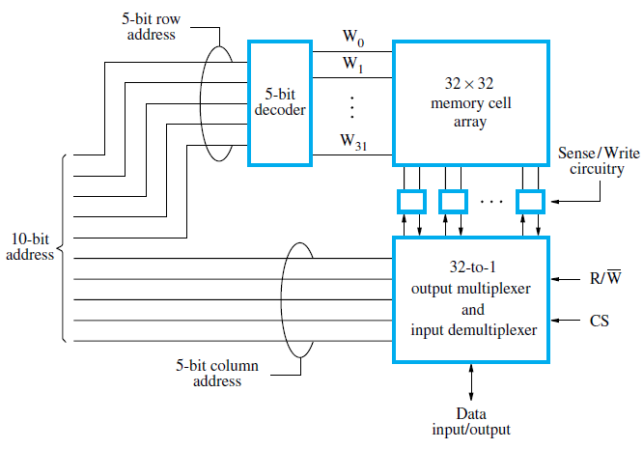
Internal Organization of Memory Chips
1K (1024) memory can be organized as a 128 × 8 memory
Requiring a total of 19 external connections.
Alternatively, the same number of cells can be organized into a 1K×1 format.
In this case, a 10-bit address is needed, but there is only one data line, resulting in 15 external connections.

Slide 89
Internal Organization of Memory Chips
The required 10-bit address is divided into two groups of 5 bits each to form the row and column addresses for the cell array.
A row address selects a row of 32 cells, all of which are accessed in parallel.
But, only one of these cells is connected to the external data line, based on the column address.
Commercially available memory chips contain a much larger number of memory cells than the examples shown
Large chips have essentially the same organization as the later, but use a larger memory cell array and have more external connections.
For example, a 1G-bit chip may have a 256M × 4 organization, in which case a 28-bit address is needed and 4 bits are transferred to or from the chip.

Slide 90
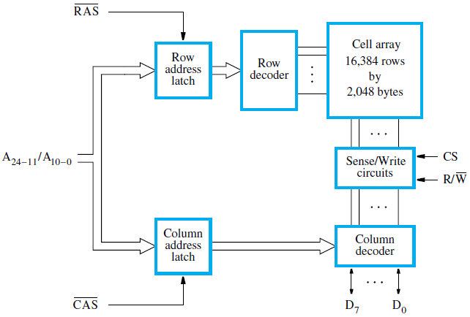
Internal organization of a 32M × 8 dynamic memory chip.

Slide 91
Structure of larger memories
Memory systems connected to form larger memories
There are 2 types of memory systems
Static memory systems
Dynamic memory systems

Slide 92
Structure of Larger Memories -Static Memory Systems
Implementation of 2M X 32 memory using sixteen 512K X 8 static memory chips
There are 4 columns, each column containing 4 chips to implement one byte position
Only selected chips ( chip select =1) place data on output lines, outputs of other chips are in high impedance state.
21 address bits are needed to select a 32 bit word in this memory
Higher order 2 bits used to determine which of the 4 chip select signals should be activated
19 bits used to access specific byte locations inside each chip of selected row
R/W inputs of each chip are tied together to form a single R/W signal

Slide 93
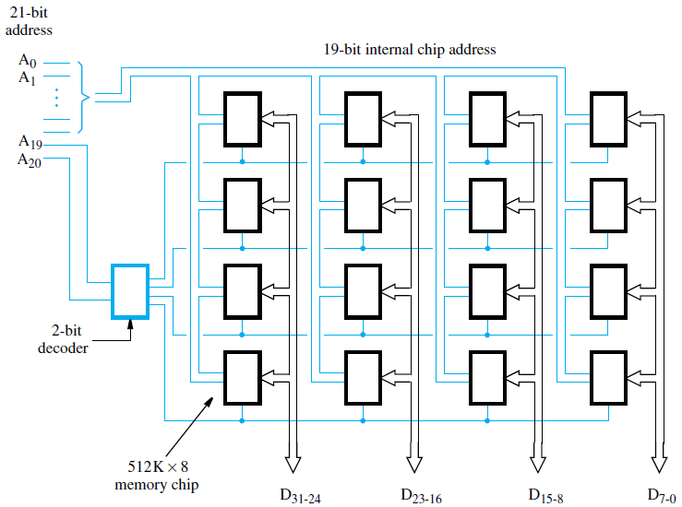
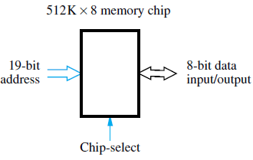
Structure of Larger Memories -Static Memory Systems

Slide 94
Structure of Larger Memories-Dynamic Memory Systems
Modern computers use very large memories.
A large memory leads to better performance, because more of the programs and data used in processing can be held in the memory, thus reducing the frequency of access to secondary storage.
Because of their high bit density and low cost, dynamic RAMs, mostly of the synchronous type, are widely used in the memory units of computers.
They are slower than static RAMs, but they use less power and have considerably lower cost per bit.
To reduce the number of memory chips needed in a given computer, a memory chip may be organized to read or write a number of bits in parallel.
Chips are manufactured in different organizations, to provide flexibility in designing memory

Slide 95
Module 5
ROM

Slide 96
ROMs
SRAM and SDRAM chips are volatile: Lose the contents when the power is turned off. Many applications need memory devices to retain contents after the power is turned off.
For example, computer is turned on; the operating system must be loaded from the disk into the memory.
For this we need to store instructions which would load the OS from the disk that they will not be lost after the power is turned off. So we need to store the instructions into a non-volatile memory.
Non-volatile memory is read in the same manner as volatile memory.
The normal operation involves only reading of data, this type of memory is called Read-Only memory (ROM).
The data are written into a ROM when it is manufactured and is permanent memory.

Slide 97
ROMs
At Logic value ‘0’: Transistor(T) is connected to the ground point(P). Transistor switch is closed & voltage on bit line nearly drops to zero.
At Logic value ‘1’: Transistor switch is open. The bit line remains at high voltage.
To read the state of the cell, the word line is activated. A Sense circuit at the end of the bit line generates the proper output value.

Slide 98
Types of ROM
Different types of non-volatile memory are
PROM
EPROM
EEPROM
Flash Memory

Slide 99
Programmable Read-Only Memory (PROM):
PROM allows the data to be loaded by the user.
Programmability is achieved by inserting a ‘fuse’ at point P in a ROM cell. Before it is programmed, the memory contains all 0’s. The user can insert 1’s at the required location by burning out the fuse at these locations using high-current pulse.
This process is irreversible.
The PROMs provides flexibility and faster data access. It is less expensive because they can be programmed directly by the user.

Slide 100
Erasable Reprogrammable Read-Only Memory (EPROM):
EPROM allows the stored data to be erased and new data to be loaded.
In an EPROM cell, a connection to ground is always made at ‘P’ and a special transistor is used, which has the ability to function either as a normal transistor or as a disabled transistor that is always turned ‘off’.
During programming, an electrical charge is trapped in an insulated gate region.
The charge is retained for more than 10 years because the charge has no leakage path. For erasing this charge, ultra-violet light is passed through a quartz crystal window (lid).
This exposure to ultra-violet light dissipates the charge. During normal use, the quartz lid is sealed with a sticker.
EPROM can be erased by exposing it to ultra-violet light for duration of up to 40 minutes. Usually, an EPROM eraser achieves this function.

Slide 101
Merits:
It provides flexibility during the development phase of digital system.
It is capable of retaining the stored information for a long time.
Demerits:
The chip must be physically removed from the circuit for reprogramming and its entire contents are erased by UV light.

Slide 102
Electrically Erasable Programmable Read-Only Memory (EEPROM):
EEPROM is programmed and erased electrically.
It can be erased and reprogrammed about ten thousand times. Both erasing and programming take about 4 to 10 ms (millisecond). In EEPROM, any location can be selectively erased and programmed.
EEPROMs can be erased one byte at a time, rather than erasing the entire chip. Hence, the process of reprogramming is flexible but slow.
Merits: It can be both programmed and erased electrically. It allows the erasing of all cell contents selectively.
Demerits: It requires different voltage for erasing ,writing and reading the stored data.

Slide 103
Flash memory:
Flash memory is a non-volatile memory chip used for storage and for transferring data between a personal computer (PC) and digital devices.
It has the ability to be electronically reprogrammed and erased. It is often found in USB flash drives, MP3 players, digital cameras and solid-state drives.
Flash memory is a type of electronically erasable programmable read only memory (EEPROM), but may also be a standalone memory storage device such as a USB drives.
EEPROM is a type of data memory device using an electronic device to erase or write digital data.

Slide 104
Flash memory is a distinct type of EEPROM, which is programmed and erased in large blocks.
Flash memory incorporates the use of floating-gate transistors to store data. Floating-gate transistors, or floating gate MOSFET (FGMOS), is similar to MOSFET, which is a transistor used for amplifying or switching electronic signals.
Floating-gate transistors are electrically isolated and use a floating node in direct current (DC). Flash memory is similar to the standard MOFSET, except the transistor has two gates instead of one.

Slide 105
SPEED, SIZE AND COST
A big challenge in the design of a computer system is to provide a sufficiently large memory, with a reasonable speed at an affordable cost.
Static RAM: Very fast, but expensive, because a basic SRAM cell has a complex circuit making it impossible to pack a large number of cells onto a single chip.
Dynamic RAM: Simpler basic cell circuit, hence are much less expensive, but significantly slower than SRAMs.
Magnetic disks: Storage provided by DRAMs is higher than SRAMs, but is still less than what is necessary. Secondary storage such as magnetic disks provides a large amount of storage, but is much slower than DRAMs.

Slide 106
Module 5
Content addressable memory
CST 202 : Computer Organization
& Architecture

Slide 107
CONTENT ADDRESSABLE MEMORY (CAM)/ ASSOCIATIVE MEMORY
Many data-processing applications require the search of items in a table stored in memory.
An assembler program searches the symbol address table in order to extract the symbol’s binary equivalent. An account number may be searched in a file to determine the holder’s name and account status.
The established way to search a table is to store all items where they can be addressed in sequence.
The search procedure is a strategy for choosing a sequence of addresses, reading the content of memory at each address, and comparing the information read with the item being searched until a match occurs.
The number of accesses to memory depends on the location of the item and the efficiency of the search algorithm.

Slide 108
The time required to find an item stored in memory can be reduced considerably if stored data can be identified for access by the content of the data itself rather than by an address
A memory unit accessed by content is called an associative memory or Content Addressable Memory (CAM).
This type of memory is accessed simultaneously and in parallel on the basis of data content rather than by specific address or location.
When a word is written in an associative memory, no address is given. The memory is capable of finding an empty unused location to store the word.
When a word is to be read from an associative memory, the content of the word, or part of the word, is specified.

Slide 109
The memory locaters all words which match the specified content and marks them for reading.
Because of its organization, the associative memory is uniquely suited to do parallel searches by data association.
An associative memory is more expensive then a random access memory because each cell must have storage capability as well as logic circuits for matching its content with an external argument.
For this reason, associative memories are used in applications where the search time is very critical and must be very short.

Slide 110
HARDWARE ORGANIZATION(CONTENT ADDRESSABLE MEMORY )
The block diagram of an associative memory consists of a memory array and logic from words with n bits per word. The argument register A and key register K each have n bits, one for each bit of a word.
Block Diagram of Associative Memory

Slide 111
The match register M has m bits, one for each memory word. Each word in memory is compared in parallel with the content of the argument register.
The words that match the bits of the argument register set a corresponding bit in the match register.
After the matching process, those bits in the match register that have been set indicate the fact that their corresponding words have been matched.
Reading is accomplished by a sequential access to memory for those words whose corresponding bits in the match register have been set.
The key register provides a mask for choosing a particular field or key in the argument word.
The entire argument is compared with each memory word if the key register contains all 1’s. Otherwise, only those bits in the argument that have 1’s in their corresponding position of the key register are compared. Thus the key provides a mask or identifying piece of information which specifies how the reference to memory is made.

Slide 112
To illustrate with a numerical example, suppose that the argument register A and the key register K have the bit configuration shown below. Only the three leftmost bits of A are compared with memory words because K has 1’s in these positions.
Word 2 matches the unmasked argument field because the three leftmost bits of the argument and the word are equal.

Slide 113
The relation between the memory array and external registers in an associative memory is shown in below figure.

Slide 114
The cells in the array are marked by the letter C with two subscripts.
The first subscript gives the word number and the second specifies the bit position in the word.
Thus cell Cij is the cell for bit j in word i. A bit A j in the argument register is compared with all the bits in column j of the array provided that K j =1.
This is done for all columns j = 1, 2,…,n. If a match occurs between all the unmasked bits of the argument and the bits in word i, the corresponding bit Mi in the match register is set to 1.
If one or more unmasked bits of the argument and the word do not match, Mi is cleared to 0.
Flop storage element Fij and the circuits for reading, writing, and matching the cell. The input bit is transferred into the storage cell during a write operation.
The bit stored is read out during a read operation.
The match logic compares the content of the storage cell with the corresponding unmasked bit of the argument and provides an output for the decision logic that sets the bit in Mi.

Slide 115
READ OPERATION
The matched words are read in sequence by applying a read signal to each word line whose corresponding Mi bit is a 1.
In most applications, the associative memory stores a table with no two identical items under a given key.
In this case, only one word may match the unmasked argument field.
By connecting output Mi directly to the read line in the same word position (instead of the M register), the content of the matched word will be presented automatically at the output lines and no special read command signal is needed.
Furthermore, if we exclude words having a zero content, an all-zero output will indicate that no match occurred and that the searched item is not available in memory.
WRITE OPERATION
If the entire memory is loaded with new information at once prior to a search operation then the writing can be done by addressing each location in sequence.

Slide 116
This will make the device a random-access memory for writing and a content addressable memory for reading.
The advantage here is that the address for input can be decoded as in a random-access memory. Thus instead of having m address lines, one for each word in memory, the number of address lines can be reduced by the decoder to d lines, where m = 2d.
If unwanted words have to be deleted and new words inserted one at a time, there is a need for a special register to distinguish between active and inactive words.
This register, sometimes called a tag register, would have as many bits as there are words in the memory.
For every active word stored in memory, the corresponding bit in the tag register is set to 1. A word is deleted from memory by clearing its tag bit to 0.
Words are stored in memory by scanning the tag register until the first 0 bit is encountered.
This gives the first available inactive word and a position for writing a new word. After the new word is stored in memory it is made active by setting its tag bit to 1. An unwanted word when deleted from memory can be cleared to all 0’s if this value is used to specify an empty location.

Slide 117
Module 5
Cache memories
CST 202 : Computer Organization
& Architecture

Slide 118
Cache Memory
The processor of a computer can usually process instructions and data faster than they can be fetched from the main memory.
The memory access time is the bottleneck in the system.
One way to reduce the memory access time is to use a cache memory.
This is a small, fast memory inserted between the larger, slower main memory and the processor.
It holds the currently active portions of a program and their data.

Slide 119
2 Types of Cache Memory
Cache memory is divided into two categories depending on its physical location and proximity to the device’s CPU.
Primary Cache Memory: The primary cache memory, also known as the main cache memory, is the SRAM located on the same die as the CPU, which is as close as it can be installed. This is the type generally used in the storage and retrieval of information between the CPU and the RAM.
Secondary Cache Memory: The secondary cache memory is the same hardware as the primary cache memory. However, it’s placed further away from the CPU, ensuring the existence of a backup SRAM that can be reached by the CPU whenever needed.

Slide 120
Cache Memory
Cache memory is used to reduce the average time to access data from the Main memory.
The cache is a smaller and faster memory which stores copies of the data from frequently used main memory locations.
There are various different independent caches in a CPU, which store instructions and data.
Locality of Reference
Analysis of programs indicates that many instructions in localized areas of a program are executed repeatedly during some period of time, while the others are accessed relatively less frequently. These instructions may be the ones in a loop, nested loop or few procedures calling each other repeatedly. This is called “locality of reference”.
Temporal locality of reference: Recently executed instruction is likely to be executed again very soon.
Spatial locality of reference: Instructions with addresses close to a recently instruction are likely to be executed soon.

Slide 121
Basic Cache Operations
Processor issues a Read request; a block of words is transferred from the main memory to the cache, one word at a time.
Subsequent references to the data in this block of words are found in the cache.
At any given time, only some blocks in the main memory are held in the cache, which blocks in the main memory in the cache is determined by a “mapping function”.
When the cache is full, and a block of words needs to be transferred from the main memory, some block of words in the cache must be replaced. This is determined by a “replacement algorithm”.
Cache hit :
Existence of a cache is transparent to the processor. The processor issues Read and Write requests in the same manner. If the data is in the cache, it is called a Read or Write hit.

Slide 122
Read hit: The data is obtained from the cache.
Write hit:
Cache has a replica of the contents of the main memory. Contents of the cache and the main memory may be updated simultaneously.
This is the write-through protocol. Update the contents of the cache, and mark it as updated by setting a bit knownas the dirty bit or modified bit.
The contents of the main memory are updatedwhen this block is replaced. This is write-back or copy-back protocol.
If the data is not present in the cache, then a Read miss or Write miss occurs.

Slide 123
Basic Cache Operations
Read miss: Block of words containing this requested word is transferred from the memory. After the block is transferred, the desired word is forwarded to the processor. The desired word may also be forwarded to the processor as soon as it is transferred without waiting for the entire block to be transferred. This is called load-through or early restart.
Write-miss: Write-through protocol is used, and then the contents of the main memory are updated directly. If write-back protocol is used, the block containing the addressed word is first brought into the cache. The desired word is overwritten with new information.

Slide 124
Module 5
Mapping functions
CST 202 : Computer Organization
& Architecture

Slide 125
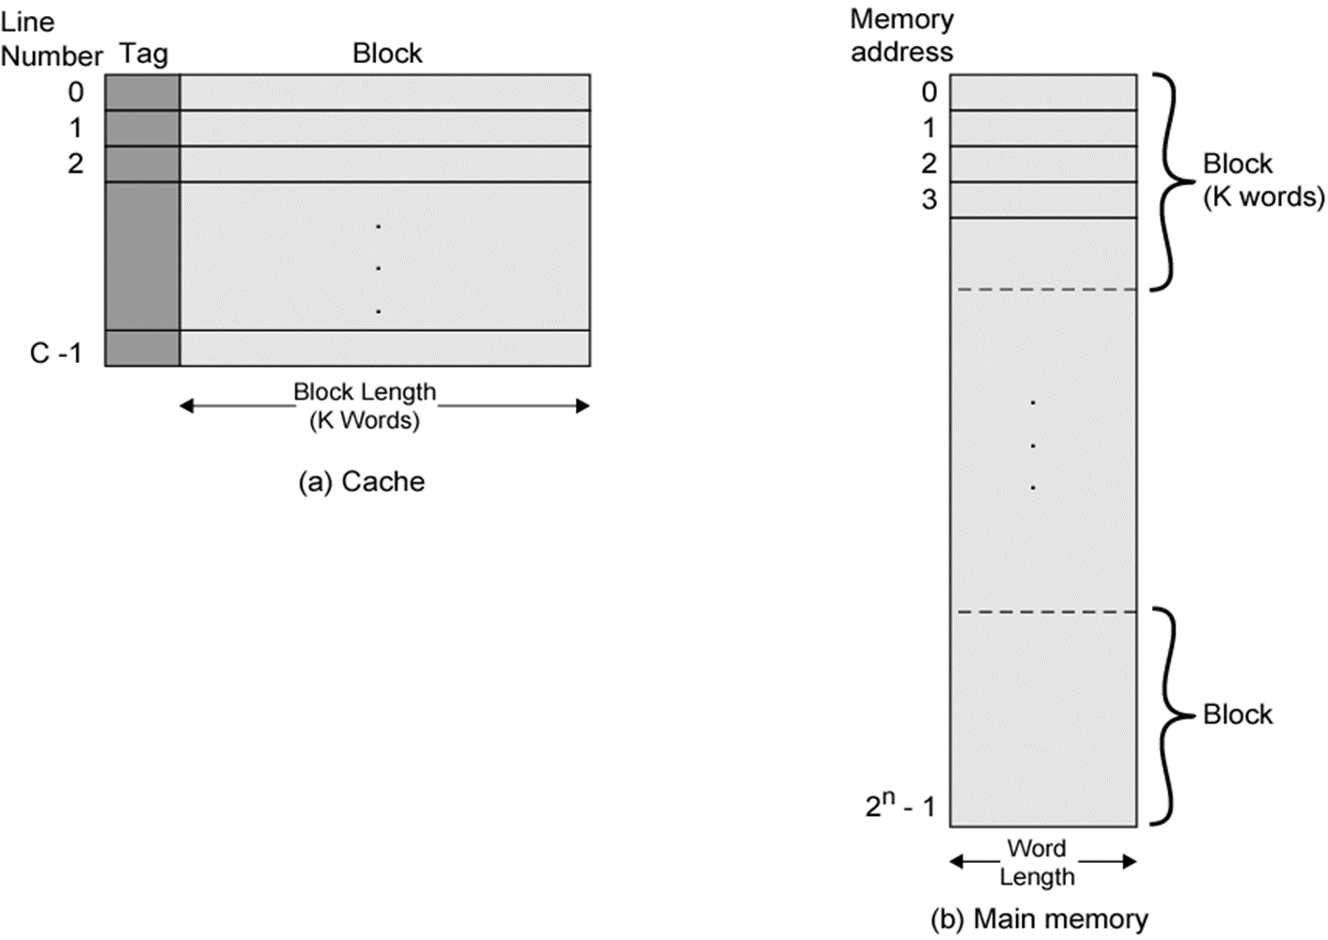
Cache/ Main Memory Structure

Slide 126
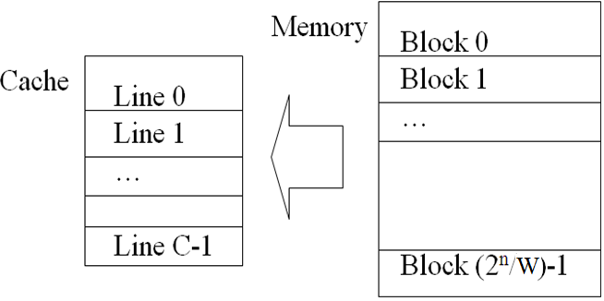
Cache Design
If memory contains 2^{n} addressable words
Memory can be broken up into blocks with W words per block.
Number of blocks M = 2^{n} / W
Cache consists of C lines or slots, each consisting of W words
C << M
How to map blocks of memory to lines in the cache?

Slide 127
Mapping functions
The mapping functions are used to map a particular block of main memory to a particular block of cache.
This mapping function is used to transfer the block from main memory to cache memory.
Mapping functions determine how memory blocks are placed in the cache.
Three mapping functions:
• Direct mapping.
• Associative mapping.
• Set-associative mapping.

Slide 128
Mapping functions
Eg: A processor with main memory addressable by a 16-bit address and a cache of size 2048 words and block size of 16 words
Main memory addressable by a 16-bit address
Size of Main memory = 2¹⁶ = 64K words
Size of a block = 2⁴ = 16 words
No of blocks in Main memory
= (2¹⁶ / 2⁴ ) = 2¹² = 4096 blocks of 16 words each.
Size of cache is 2048 (= 2K = 2¹¹) words
No of blocks in Cache
= (2¹¹ / 2⁴ ) = 2⁷ = 128 blocks of 16 words each

Slide 129
Direct mapping.
Simplest mapping technique - each block of main memory maps to only one cache line - i.e. if a block is in cache, it must be in one specific place
Formula to map a memory block to a cache line or cache block:
Cache block no = memory block no % number of cache lines or blocks (remainder)
b = j mod c
More than one memory block is mapped onto the same position in the cache.

Slide 130
mem blocks - 0,128,256… 3968 maps to cache block 0,
mem blocks- 1, 129,257… 3969 maps to cache block 1,
mem blocks - 127,255….4095 maps to cache block 31.
4096/128 => 32 memory blocks map to one cache block (tags)
To identify currently which memory block is in cache block, tag bits are attached to each block,
Tag no= memory block no/ number of cache lines or blocks (quotient)
May lead to contention for cache blocks even if the cache is not full.
If a program accesses 2 blocks that map to the same line repeatedly, cache misses are very high (thrashing)
Resolve the contention by allowing new block to replace the old block, leading to a trivial replacement algorithm.
Simple to implement , Inexpensive ,but not very flexible

Slide 131
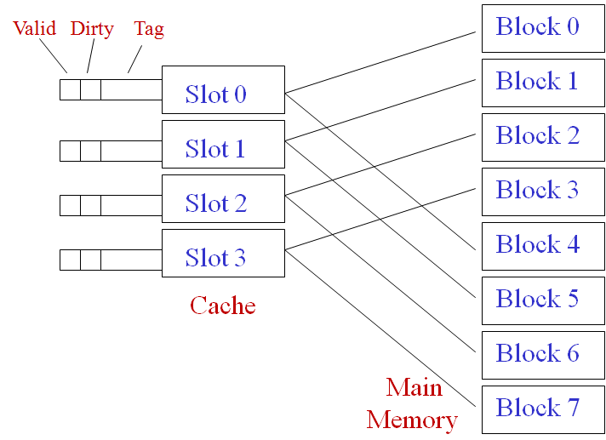
Eg: Direct Mapping with C=4
Each slot contains W words
Tag : Identifies which memory block is in the slot
Valid : Set after block copied from memory to indicate the cache line has valid data
Dirty : Set if block is modified

Slide 132
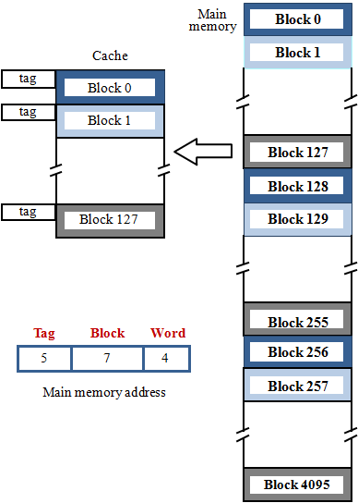
Block j of the main memory maps to
( j modulo 128 ) block of cache.
Memory address divided into three fields:
4 word bits – which one of 16 words (each block has 16=2⁴ words)
7 block bits – to which cache line or block
to place this memory block (128=2⁷)
b = j mod c
5 tag bits - compared with the tag bits associated with its location in the cache. Identify which one of 32 blocks (32 =2⁵) is currently resident in the cache
t = j / c
Tag no = Mem block No / Total No of cache blocks
No of tags in a block (tag bits)
=Total No of mem blocks / Total No of Cache blocks
Cache block no = Mem block No % Total No of cache blocks

Slide 133
Direct Mapping
b = Cache block no = Mem block No % Total No of cache blocks
t = Tag no = Mem block No / Total No of cache blocks
No of tags in a block = Total No of mem blocks/Total No of Cache blocks

Slide 134
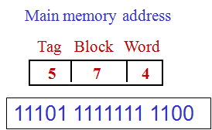
Eg: Given a memory address, in Direct mapping how to find which word it is , to which cache block it will be allocated and its tag no.
a. Find division of memory address based on Mapping (Direct)
b. No of word bits α No of words in a block (block size) (16=2⁴ words)
c. No of block bits α No of blocks in a cache (128=2⁷ cache blocks)
d. No of tag bits α No of blocks mapped into a cache block (32 =2⁵ tags)
e. Now divide given memory address as per TBW and convert to binary
Tag: 11101 = 29 (mem block with tag 29 to same cache block)
Block: 1111111 =127, cache block No:127
Word:1100=12, word no:12,
So Word: 12 of block with tag no: 29 allotted to cache block: 127

Slide 135
Fully Associative Mapping
A fully associative mapping scheme can overcome the problems of the direct mapping scheme
A main memory block can load into any line of cache
Memory address is interpreted as tag and word
Tag uniquely identifies block of memory
Every line’s tag is examined for a match
Also need a Dirty and Valid bit
Flexible, and uses cache space efficiently.
All slots searched in parallel for target
But Cache searching gets expensive!
Ideally need circuitry that can simultaneously examine all tags for a match
Lots of circuitry needed, high cost
Need replacement policies now that anything can get thrown out of the cache

Slide 136
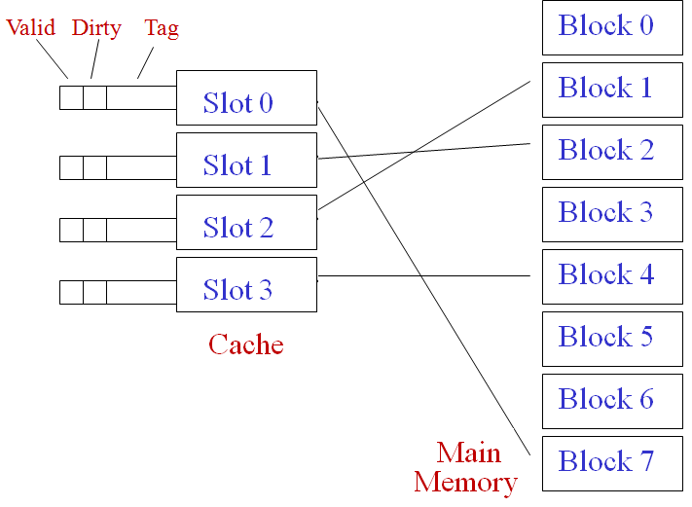
Eg: Associative Mapping
Any memory block can map to any cache slot
Tag : Identify which block is in which slot
All slots searched in parallel for target block

Slide 137
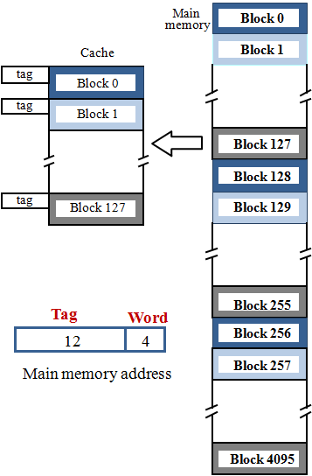
Associative mapping
Associative - Any memory block can map to any cache block
Tag No = Memory block No
No of tags = No of Memory blocks
Memory address divided into two fields:
4 word bits - which one of 16 words (each block has 16=2⁴ words)
12 tag bits - Identify which one of the 4096 blocks (4096=2¹²) is currently resident in the cache block.

Slide 138
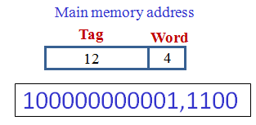
Associative Mapping
Eg: Given a memory address, in Associative mapping how to find which word it is , to which cache block it will be allocated and its tag no.
a. Find division of memory address (TW) based on Mapping (Associative)
b. No of word bits α No of words in a block (block size) (16=2⁴ words)
c. No of tag bits α No of memory blocks ( 4096 =2¹² tags)
d. Now divide given memory address as per TW and convert to binary
Tag: 100000000001 = 2049
Word: 1100 = 12
Word:12 of memory block: 2049 residing in the cache
Can be anywhere in cache. No specific position.
Searching needs to match all tags in parallel

Slide 139
Set Associative Mapping
Compromise between fully-associative and direct-mapped cache
Cache is divided into a number of sets
Each set contains a number of cache lines or blocks or slots
A given block maps to any line in a specific set
Use direct-mapping to determine which set in the cache corresponds to a set in memory
Memory block could then be in any line of that set
e.g. 2 lines per set (2 way associative mapping)
A given block can be in either of 2 lines in a specific set
e.g. K cache lines or blocks per set
K- way associative mapping
A given block can be in one of K lines in a specific set
Much easier to simultaneously search one set than all lines

Slide 140
Set Associative Mapping
Set-associative mapping combination of direct and associative mapping.
Blocks of cache are grouped into sets.
Mapping function allows a block of the main memory to reside in any block of a specific set.
Number of blocks per set is a design parameter.
One extreme is to have all the blocks in one set, not requiring any set bits
(fully associative mapping).
Other extreme is to have one block per set, is same as direct mapping
No of blocks per set = set size = k (k-way associative)
No of cache sets = No of cache blocks / k
Set No = memory block no % number of cache sets (remainder)
s = j mod (c /k)
Tag no = memory block no / number of cache sets (quotient)
t = j / (c/k)
No of Tags = Total Mem Blocks / Total Cache Sets

Slide 141
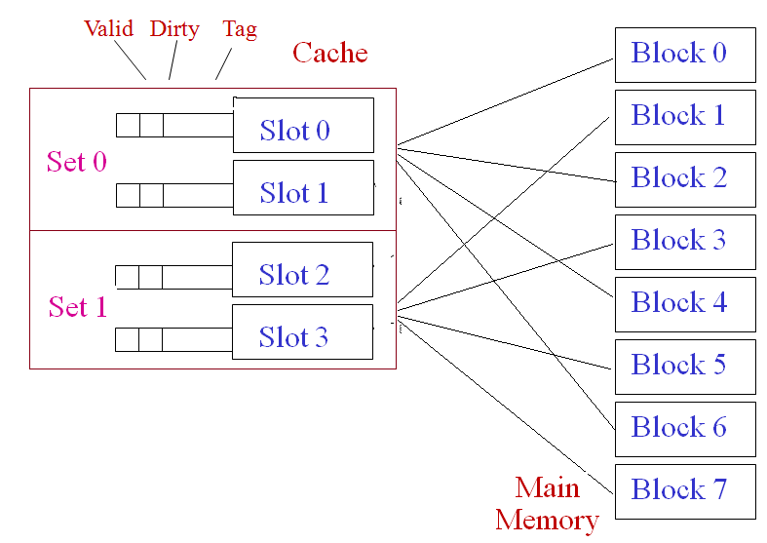
Eg: Set Associative Mapping
To compute cache set number:
Set No = j mod v
j = main memory block number
v = number of sets in cache

Slide 142
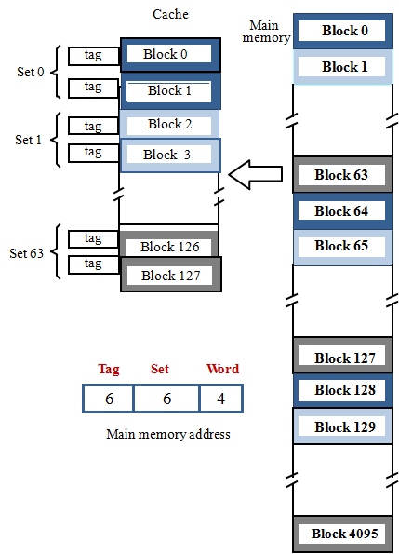
Set-Associative mapping
Divide the cache of 128 blocks into 64 sets, with two blocks per set.
Memory blocks - 0,64,128 etc. maps to block 0, occupies either of the two positions.
Memory address is divided into three fields:
4 word bits: which one of 16 words within a block (16=2⁴ words)
6 set bits: which set in the cache
(128 /2 = 64 = 2⁶)
6 tag bits: which one of 64 blocks is present in cache set (4096 / 64 = 2⁶).
Set No = memory block no % number of cache sets (remainder)
s = j mod (c /k)
Tag no = memory block no / number of cache sets (quotient)
t = j / (c/k)
No of Tags = Total Mem Blocks / Total Cache Sets

Slide 143
Set-Associative Mapping
No of Cache Sets = No of Cache Blocks / No of Blocks in a Set
s= Set No = memory block no % number of cache sets (remainder)
t =Tag No = memory block no / number of cache sets (quotient)
No of Tags = Total Mem Blocks / Total Cache Sets

Slide 144
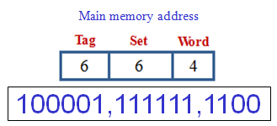
Eg: Given a memory address, in Set-Associative mapping how to find
which word it is , allocated to which cache set and its tag no.
a. Find division of memory address (TBW) as Mapping (Set-Associative)
b. No of word bits α No of words in a block (block size) (16=2⁴ words)
c. No of set bits α No of sets in a cache (64=2⁶ cache sets)
d. No of tag bits α No of blocks mapped into a cache block (64=2⁶ tags)
e. Now divide given memory address as per TSW and convert to binary
Tag: 100000 = 32 (mem block with tag 32 to same cache set)
Block: 111111 =63, cache set No: 63
Word:1100=12, word no:12
So Word: 12 of block with tag no: 32 allotted to cache set: 63

Slide 145
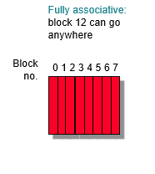
Where can a memory block be placed in cache?
Memory Block 12 to be placed in a cache of 8 blocks :
Fully Associative Mapping - No particular cache block
Direct mapping, cache block no= Block Number Modulo Number of Cache Blocks
Set Associative Mapping, cache block no = Block Number Modulo Number of Cache Sets
Direct mapped:
block 12 can go only into block 4 (12 mod 8)
Set associative:
block 12 can go anywhere in set 0 (12 mod 4)
Block
no.
0 1 2 3 4 5 6 7
Block
no.
0 1 2 3 4 5 6 7
Set
0
Set
1
Set
2
Set
3

Slide 146
Consider the memory system in which the block size in cache and main memory are equal. Cache consists of 512 blocks and main memory consists of 8192 blocks. Cache is 4-way set associative ,calculate the number of tag bits in cache?
A computer system uses 16-bit memory addresses. It has a 2K-byte cache organized in a direct-mapped manner with 64 bytes per cache block. Assume that the size of each memory word is 1 byte

Slide 147
ANSWERS
given no of lines(or blocks) in cache memory = 512
Associativaity i.e. k = 4
So no of sets = 512 / 4 = 128
But no of blocks in main memory = 8192
So no of blocks that will be mapped to same set = 8192 / 128
= 2¹³ / 2⁷⁼ 2⁶
Hence no of tag bits required = 6 bits
2. For a given 16-bit address, the 5 most significant bits, represent the Tag, the next 5 bits represent the Block, and the 6 least significant bits represent the Word.

